Slide 1
AVL TREES
DATA STRUCTURES AND ALGORITHMS
LECTURE 1
Prof: Manu

Slide 2
What is an AVL? Why AVL?
AVL tree is a self-balancing BST(binary search tree) where the difference between heights of left and right subtrees cannot be more than one for each node in the tree. In this case, height of a node is defined as the length of the longest downward path to a leaf.
AVL tree is named after its inventors Georgy Adelson-Velsky and Evgenii Landis.
All operations such as Search, Insert, Delete, Minimum, Maximum, Succesor, Predecessor take O(log n), where n is the number of nodes.

Slide 3
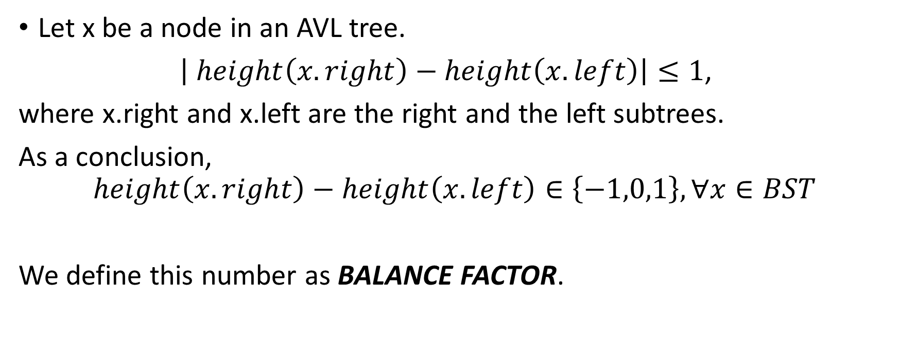
Property
Let x be a node in an AVL tree.
$\left| height\left(x.right\right)−height\left(x.left\right)\right|≤1$,
where x.right and x.left are the right and the left subtrees.
As a conclusion,
$$height\left(x.right\right)−height\left(x.left\right)∈\left\{−1,0,1\right\}, ∀x∈BST$$
We define this number as BALANCE FACTOR.

Slide 4
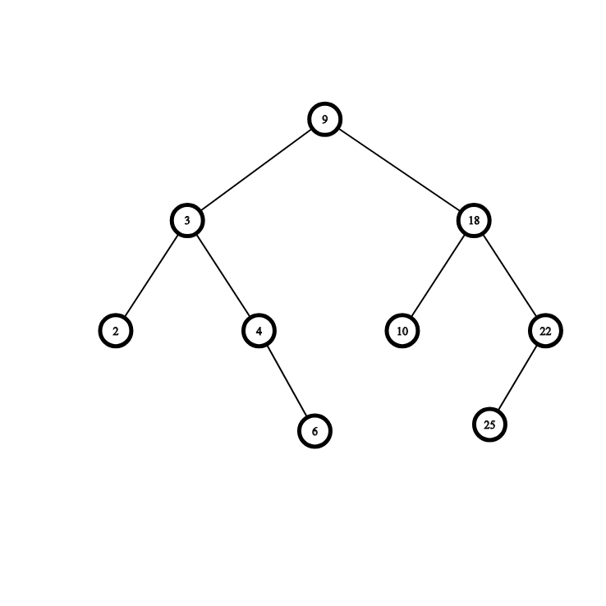
EXAMPLE:
3 0
The number colored with yellow is the height. Here, the height is inverted as the height we know for a regular tree. In this case height is:
height[x] = max{height[x.left], height[x.right]} + 1. We invert the height to recalculate the balance factor in O(1).
The number colored with blue is the balance factor.
CONVENTION: the height for a NIL node is -1.
2 -1
2 -1
0 0
1 -1
0 0
1 -1
0 0
0 0

Slide 5
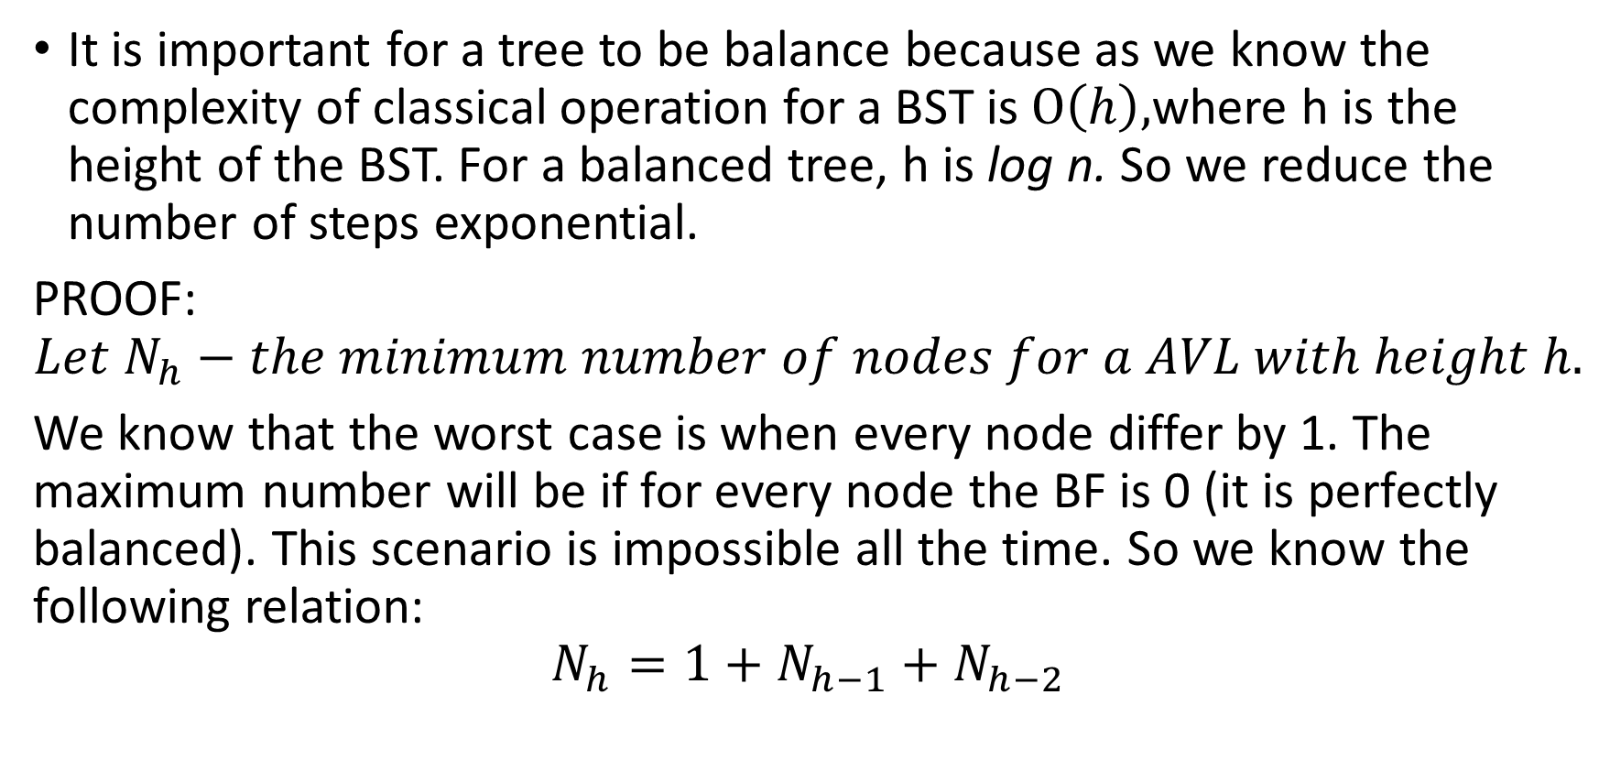
Proof of complexity
It is important for a tree to be balance because as we know the complexity of classical operation for a BST is $O\left(h\right),$where h is the height of the BST. For a balanced tree, h is log n. So we reduce the number of steps exponential.
PROOF:
$$Let N_{h}−the minimum number of nodes for a AVL with height h.$$
We know that the worst case is when every node differ by 1. The maximum number will be if for every node the BF is 0 (it is perfectly balanced). This scenario is impossible all the time. So we know the following relation:
$$N_{h}=1+N_{h−1}+N_{h−2}$$

Slide 6
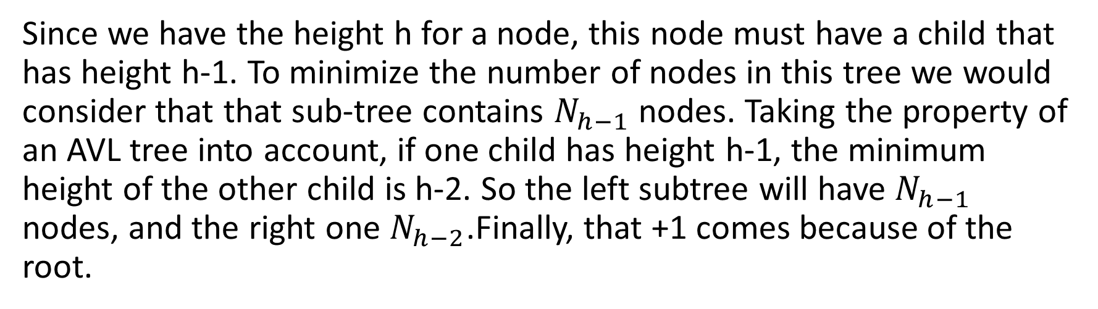
Why that relation is true?
Since we have the height h for a node, this node must have a child that has height h-1. To minimize the number of nodes in this tree we would consider that that sub-tree contains $N_{h−1}$ nodes. Taking the property of an AVL tree into account, if one child has height h-1, the minimum height of the other child is h-2. So the left subtree will have $N_{h−1}$ nodes, and the right one $N_{h−2}$.Finally, that +1 comes because of the root.

Slide 7
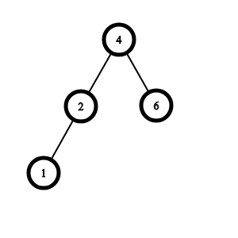
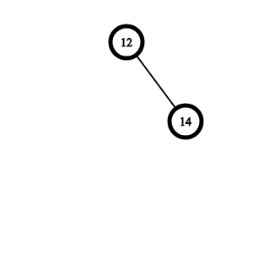

Quick example:
Base cases are: $N_{0}=1,N_{1}=2.$
For: $N_{2}=1+1+2=4→$
For: $N_{1}=1+1+0=2→$

Slide 8
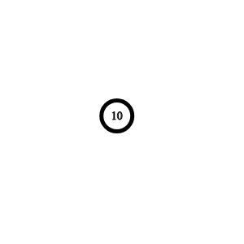



For${ N}_{3}=1+N_{1}$+$N_{2}$. So we take the previous ones and create a minimum AVL.
$${ N}_{1}$$
$${ N}_{2}$$

Slide 9
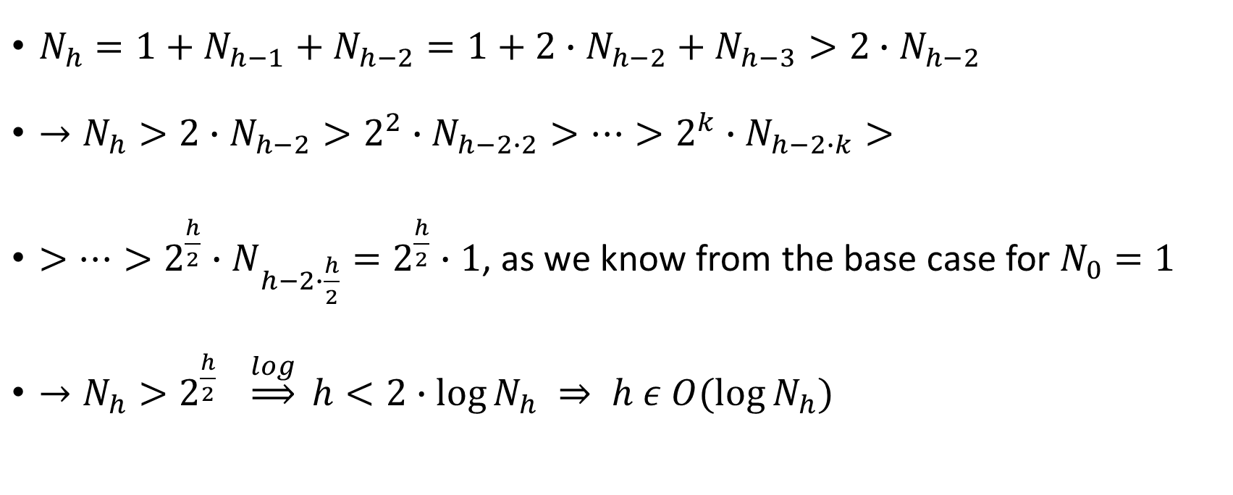
Proof:
$N_{h}=1+N_{h−1}+N_{h−2}=1+2∙N_{h−2}+N_{h−3}>2∙N_{h−2}$
$→N_{h}>2∙N_{h−2}>2^{2}∙N_{h−2∙2}>…>2^{k}∙N_{h−2∙k}>$
$>…>2^{\frac{h}{2}}∙N_{h−2∙\frac{h}{2}}=2^{\frac{h}{2}}∙1$, as we know from the base case for $N_{0}=1$
$→N_{h}>2^{\frac{h}{2}} \underset{⇒}{log} h<2∙log{N_{h} ⇒ h ε O(\log{N_{h})} }$

Slide 10
Rotations
To keep the tree balanced, we use some trickies called ROTATIONS. There are 4 of them:
Right Right Rotation or Simple Left Rotation
Left Left Rotation or Simple Right Rotation.
Left Right Rotation or Double Right Rotation.
Right Left Rotation or Double Left Rotation.
Now, we will see some examples to understand how they work. The example shows 4 cases which happen when we insert a new node. They work in mirror for when deleting a node.

Slide 11
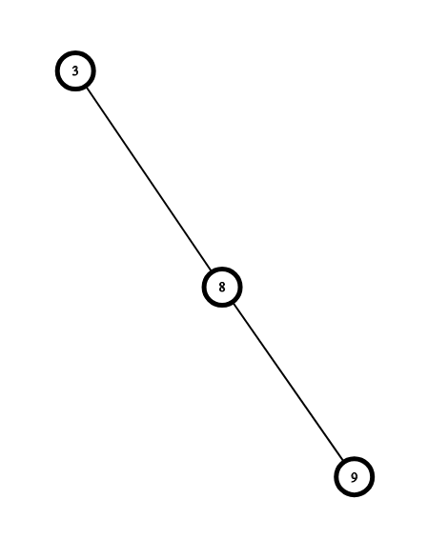
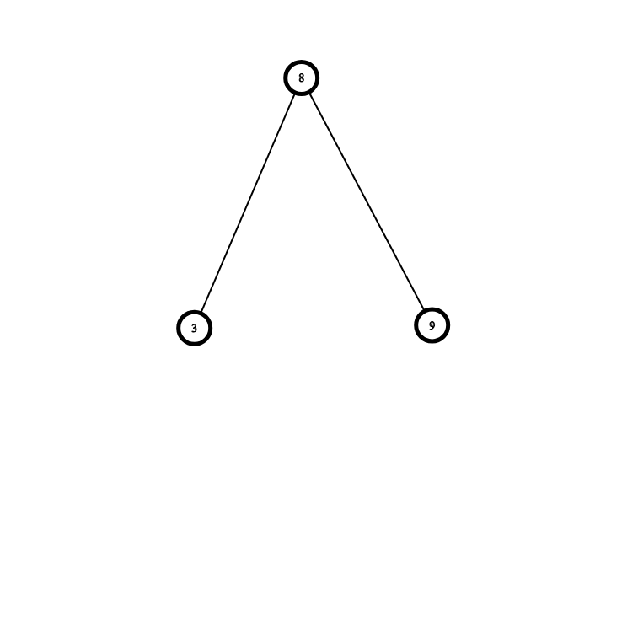
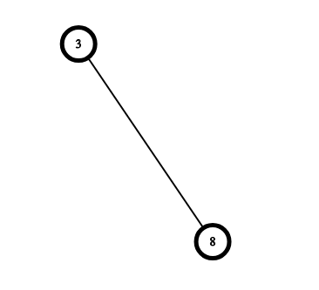


Base cases for understanding
1. Simple Left Rotation
-2
0
-1
$$\underset{⇒}{Insert 9}$$
-1
$$\underset{⇒}{SLR(3)}$$
0
0
0
0

Slide 12
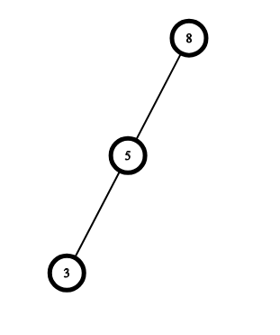
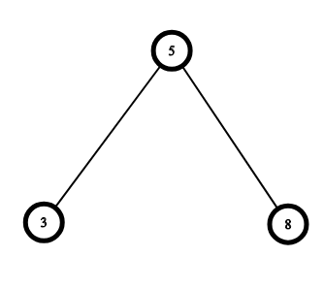
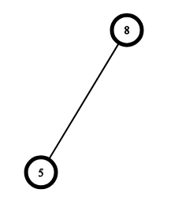


2. Simple Right Rotation
-2
1
0
$$\underset{⇒}{Insert 3}$$
-1
$$\underset{⇒}{SRR(8)}$$
0
0
0
0

Slide 13
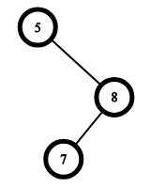
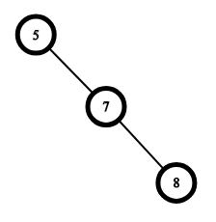
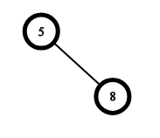
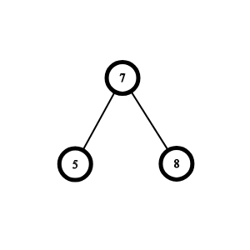



3. Double Left Rotation – consists of two rotations, one to left and one to right. Be x the node in cause. We perform one rotation to right having the left child of x as a root and then a left rotation from x.
-2
-1
$$\underset{⇒}{Insert 7}$$
1
$$\underset{⇒}{SRR(8)}$$
0
0
OBS: We cannot perform single left rotation because 8 will became the root and there won’t be a BST. The right node will be 7 which is greater than 8. Contradiction!
$$\underset{⇒}{SLR(5)}$$

Slide 14
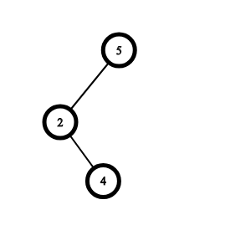
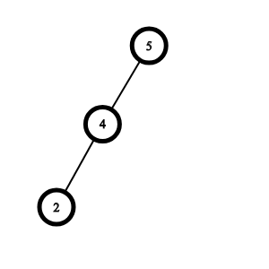
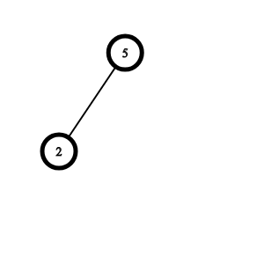
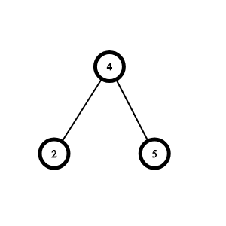



4. Double Right Rotation – consists of two rotations, one to left and one to right. Be x the node in cause. We perform one rotation to left having the right child of x as a root and then a right rotation from x.
2
1
$$\underset{⇒}{Insert 4}$$
$$\underset{⇒}{SLR(2)}$$
-1
0
0
$$\underset{⇒}{SRR(5)}$$

Slide 15
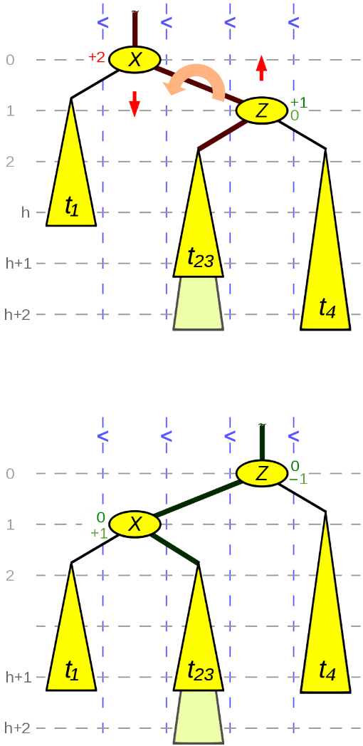
Generalisation SIMPLE LEFT ROTATION

Slide 16
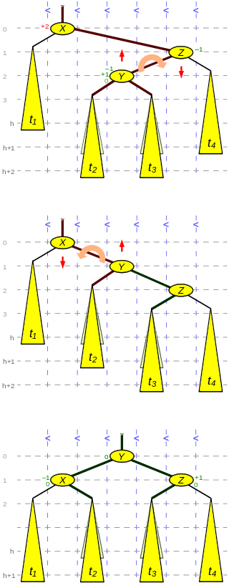
DOUBLE LEFT ROTATION.

Slide 17
Exercises:
Simulate the AVL tree for the following operations:
Insert 7, 15, 21, 18, 20, 29, 30, 9, 8.
Delete 20, 18 and 15.
Use this site to check:
https://www.cs.usfca.edu/~galles/visualization/AVLtree.html

Slide 18
Implementation details ATTENTION: SPOILERS ALERT in next pages. Do not look if you did not try by yourself.

Slide 19
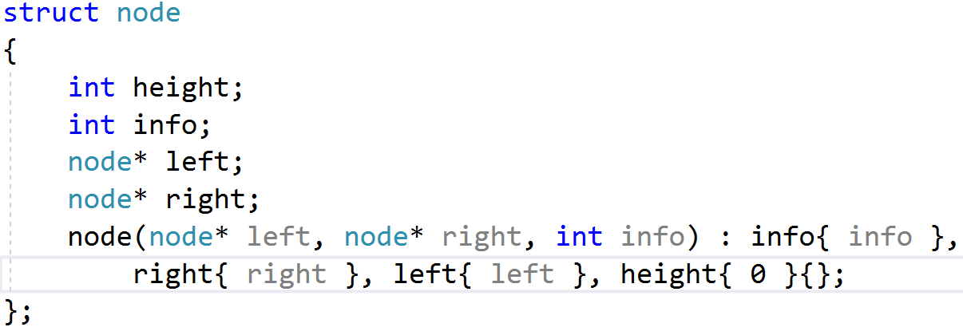

Slide 20
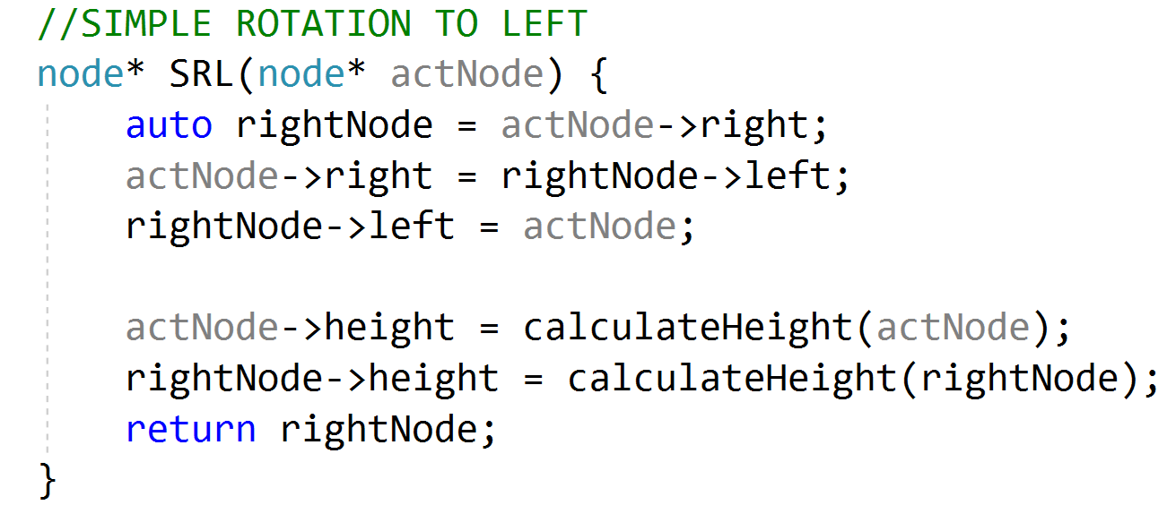

Slide 21
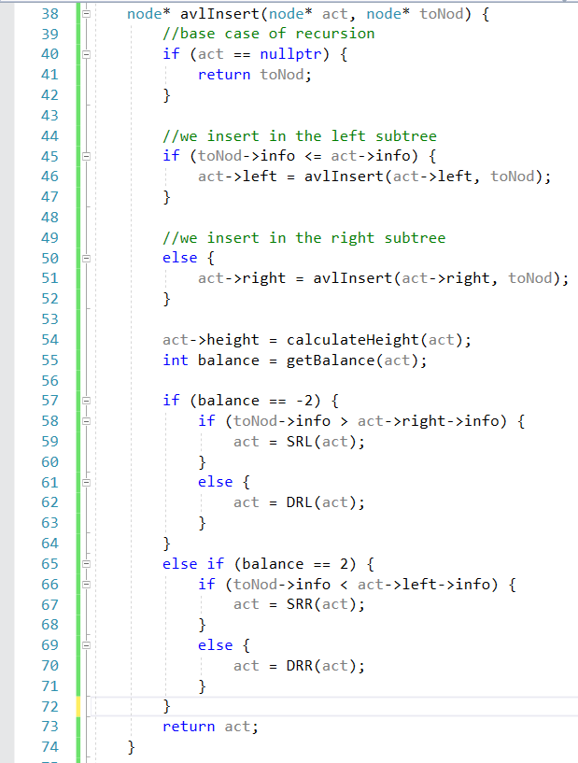
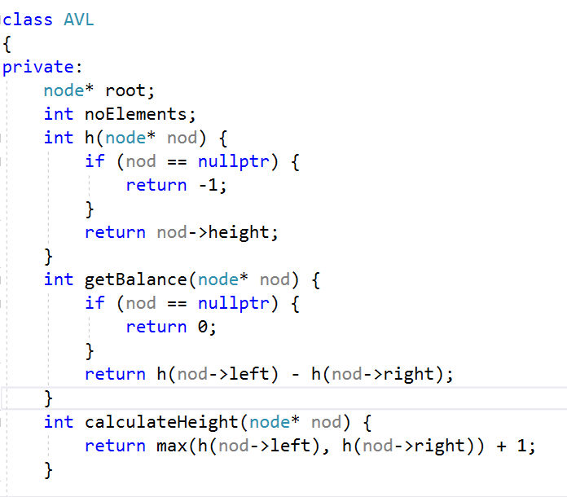

Slide 22
REFERENCES
https://www.geeksforgeeks.org/avl-tree-set-1-insertion/
https://www.geeksforgeeks.org/avl-tree-set-2-deletion/
https://en.wikipedia.org/wiki/AVL_tree
https://courses.csail.mit.edu/6.006/spring11/rec/rec04.pdf
https://www.cs.cmu.edu/~wlovas/15122-r11/lectures/18-avl.pdf
https://ocw.mit.edu/courses/electrical-engineering-and-computer-science/6-006-introduction-to-algorithms-fall-2011/lecture-videos/MIT6_006F11_lec06.pdf
https://ocw.mit.edu/courses/electrical-engineering-and-computer-science/6-006-introduction-to-algorithms-fall-2011/lecture-videos/MIT6_006F11_lec06_orig.pdf
https://ipfs.io/ipfs/QmXoypizjW3WknFiJnKLwHCnL72vedxjQkDDP1mXWo6uco/wiki/AVL_tree.html

